Slide 1

Code optimization & refactoring
LANA DŽIDIĆ

Slide 2

http://jsbin.com/tadihehewa/edit?js,console
https://jsbin.com/yamuyeqabe/edit?js,console

Slide 3
What is refactoring?
When to refactor?
How to refactor?
What are ‘code smells’

Slide 4

IF IT WORKS, DON’T FIX IT!
How long does it take to introduce a change?
How long does it take to introduce a new feature?
How flexible is the system?

Slide 5
REFACTORING
Change made to the internal structure of software to make it easier to understand and cheaper to modify without changing its observable behavior.
...improving your code without writing new functionality...
...applying a series of small behavior-preserving transformations...

Slide 6
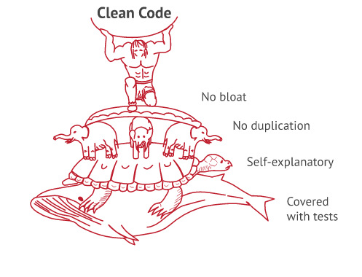

Slide 7
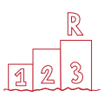
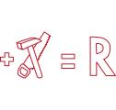
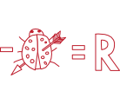
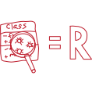
WHEN TO REFACTOR
Rule of Three
When adding a feature
When fixing a bug
During code review

Slide 8
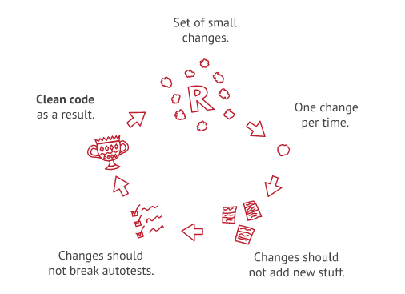
HOW TO REFACTOR

Slide 9
CODE SMELL
...a code smell is a surface indication that usually corresponds to a deeper problem in the system
If something smells, it definitely needs to be checked out, but it may not actually need fixing or might have to just be tolerated

Slide 10
CODE SMELL - BLOATERS
Code/methods/classes that are HUGE
Hard to work with
They accumulate over time as program evolves
Long method - 10 lines of code
Large class - many fields/methods/lines of code
Primitive obsession - primitives instead of small objects
Long parameter list - more than 3-4 parameters
Data clumps - different parts of the code contain identical groups of variables

Slide 11
CODE SMELL - DISPENSABLES
Something pointless and unneeded
Removing them would make the code cleaner, more efficient and easier to understand.
Comments - method filled with explanatory comments
Duplicate code - almost identical code fragments
Lazy class - near-useless code
Data class - classes with only data and getters/setters
Dead code - usually obsolete code
Speculative generality - an unused class, method, field or parameter

Slide 12
CODE SMELL - CHANGE PREVENTERS
Change in one place in code requires many changes in other places too
Divergent change - changes in many methods in a single class upon making changes to a class
Shotgun surgery - any modifications requires many changes to many different classes
Parallel inheritance hierarchies - creating a subclass for a class requires creating a subclass for another class

Slide 13
CODE SMELL - COUPLERS
Excessive coupling between classes
Feature envy - accesses data of another object more than its own
Inappropriate intimacy - class uses internal fields and methods of another class
Message chains - requests another object, that object requests yet another one, and so on
Middle man - class that only delegates work to another one

Slide 14
Zadatak 1
Zadatak 2

Slide 15
ZA VJEŽBU
Pronađite code smell-ove u sljedećem kodu (i pokušajte ih ispraviti): http://jsbin.com/xepusic/edit?html,js,output CODE

Slide 16

That‘s all folks!

